Slide 1
Simulation and Modeling
CSE4131_CSE4132

Slide 2
Tests For Random Numbers
Five types of tests:
Frequency test
Runs Test
Autocorrelation test
Gap test
Poker test
Uniformity test
Independence test

Slide 3
Runs Test (2012)
Usually 3 types of tests…
Runs up and down.
Runs above and below the mean.
Runs test: length of runs.

Slide 4

Runs Test (Runs up and Runs down)
Suppose a random number generator generates the following numbers:
Frequency test will say answer → generated numbers are uniformly distributed
But…

Slide 5

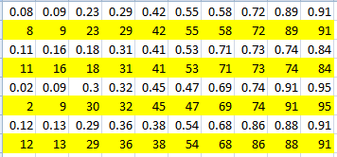

Slide 6


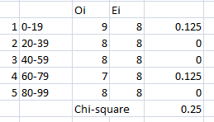
0.207 ≤ chi² ≤ 14.86

Slide 7
Runs Test (Runs up and Runs down) (2012)
Suppose a random number generator generates the following numbers:
Frequency test will say answer → generated numbers are uniformly distributed
But…

Slide 8

Runs Tests (Runs up and Runs down)
If we re-arrange the numbers…then its ok
The runs test examines the arrangement of numbers in a sequence to test the hypothesis of independence

Slide 9
Runs Tests (Runs up and Runs down)
A run is defined as :
a succession of similar events proceeded and followed by a different event
E.g. in a sequence of tosses of a coin, we may have
H T T H H T T T H T
The first toss is proceeded and the last toss is followed by a "no event".

Slide 10
Runs Tests (Runs up and Runs down)
H T T H H T T T H T
This sequence has six runs,
first with a length of one,
second and third with length two,
fourth length three, fifth and sixth length one.

Slide 11
Runs Tests (Runs up and Runs down)
A few features of a run
two characteristics:
number of runs and
the length of run
An up run is a sequence of numbers each of which is succeeded by a larger number;
A down run is a sequence of numbers each of which is succeeded by a smaller number

Slide 12


Runs Tests (Runs up and Runs down)

Slide 13
Runs Tests (Runs up and Runs down)
If a sequence of numbers have too few runs,
it is unlikely a real random sequence.
0.08, 0.18, 0.23, 0.36, 0.42, 0.55, 0.63, 0.72, 0.89, 0.91
The sequence has one run, an up run.
It is not likely a random sequence.

Slide 14
Runs Tests (Runs up and Runs down)
If a sequence of numbers have too many runs,
it is unlikely a real random sequence.
0.08, 0.93, 0.15, 0.96, 0.26, 0.84, 0.28, 0.79, 0.36, 0.57
It has nine runs, five up and four down.
It is not likely a random sequence.
If N is the number of numbers in a sequence , the maximum
number of runs is N-1 and the minimum number of runs is one

Slide 15


Runs Tests (Runs up and Runs down)
If a is the total number of runs in a truly random sequence, the mean and variance of a is given by
For ,N>20 the distribution of a is reasonably approximated by a normal distribution N(μ_{a},σ_{a}²)
N is the number of numbers in a sequence

Slide 16
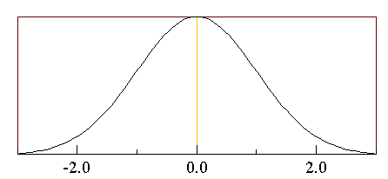

Runs Tests (Runs up and Runs down)
Normal Distribution → ?
In statistics, a distribution is the set of all possible values for terms that represent defined events.
All normal distributions are symmetric and have bell-shaped density curves with a single peak

Slide 17


Runs Tests (Runs up and Runs down)
Test statistics:

Slide 18
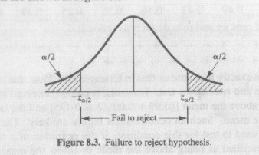
Runs Tests (Runs up and Runs down)
Failure to reject the hypothesis of independence occurs when
–z_{α/2}≤ Z₀ ≤ z_{α/2}
Where α is the level of significance

Slide 19
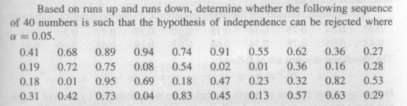

Runs Tests (Runs up and Runs down)

Slide 20
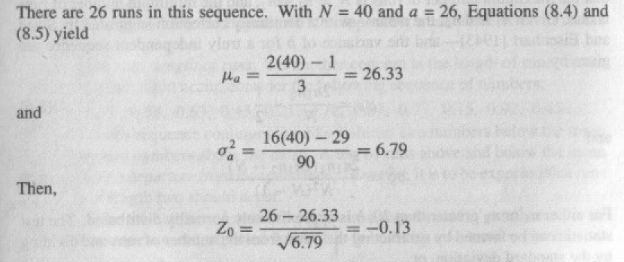

Slide 21
